Slide 1
Medicare Beneficiary Sales Presentation and Enrollment
Broker Training
10182021

Slide 2
Module Description
This module is designed to review:
The Sales Presentation Process
Scope of Appointment
How to Conduct a Sales Presentation
Virtual Sales Presentation
Medicare Beneficiary Enrollment
Expectations After Submitting the Signed Application
Broker Responsibilities

Slide 3
Sales Presentation Process
The sales presentation process can be broken down into four main steps:
Beneficiary initiates contact
Broker completes Scope of Appointment
Broker conducts sales presentation
Broker enrolls Medicare beneficiary and submits a signed application

Slide 4
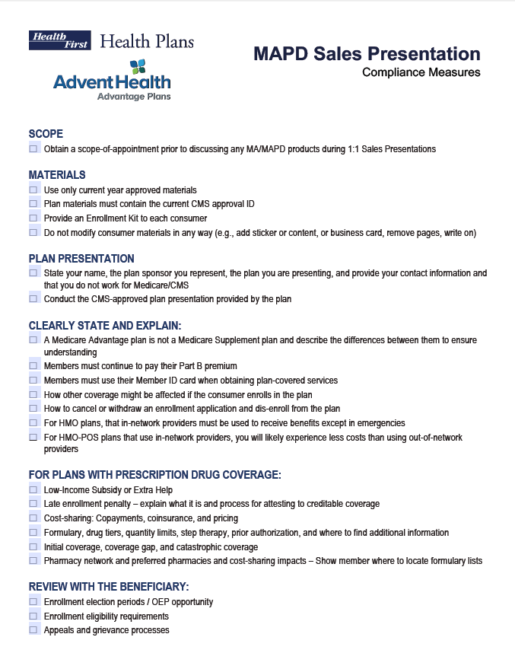
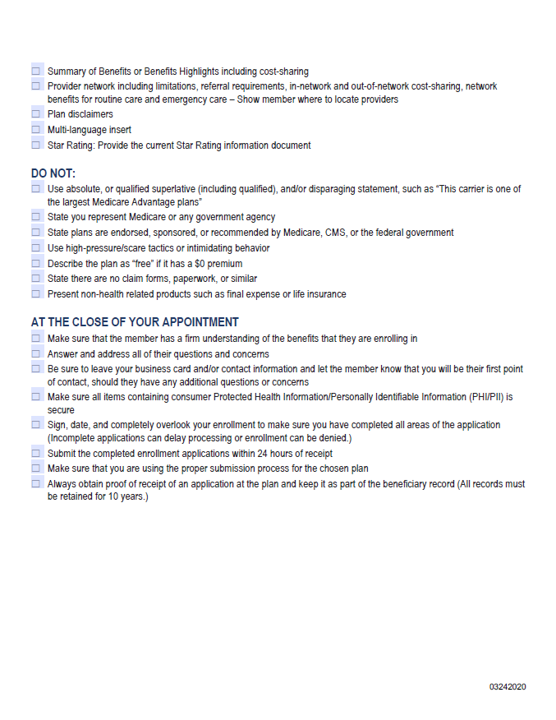
Sales Presentation Process
It is necessary that Brokers follow all compliance measures when conducting a MAPD Sales Presentation. We have prepared a checklist to guide you through this process. As you meet with prospective members, it is important to cover each step.
The MAPD Sales Presentation Compliance Checklist can be obtained from the public website Brokers page under Medicare Flyers.

Slide 5
Sales Presentation Process
Step 1: Beneficiary Initiates Contact
In order for brokers to reach out and conduct a sales appointment with a Medicare beneficiary, it is a requirement that the beneficiary initiates the contact.
Brokers must receive from the Medicare beneficiary:
An inbound call, or
A written request, or
An electronic request
Brokers may send out business reply cards or flyers to collect permission to contact. Ultimately, the beneficiary must initiate the communication. Examples of consent may begin with a business reply card response, inbound call inquiry or online form.

Slide 6
Scope of Appointment
Step 2: Broker Completes Scope of Appointment (SOA)
The Centers for Medicare & Medicaid Services (CMS) requires brokers to document the scope of a marketing appointment prior to any sales meeting to ensure understanding of what will be discussed between the broker and the Medicare beneficiary (or their authorized representative). Brokers may discuss only those products that were agreed upon in advance. The SOA should be signed and gathered by the prospective member before the appointment.
Only CMS-approved SOA forms can be used. Prospects must initial the product(s) they agree to discuss at the appointment, sign and return the SOA to the broker. An SOA is valid until used or until the end of the applicable election period. If a second meeting takes place, a new scope is required.

Slide 7
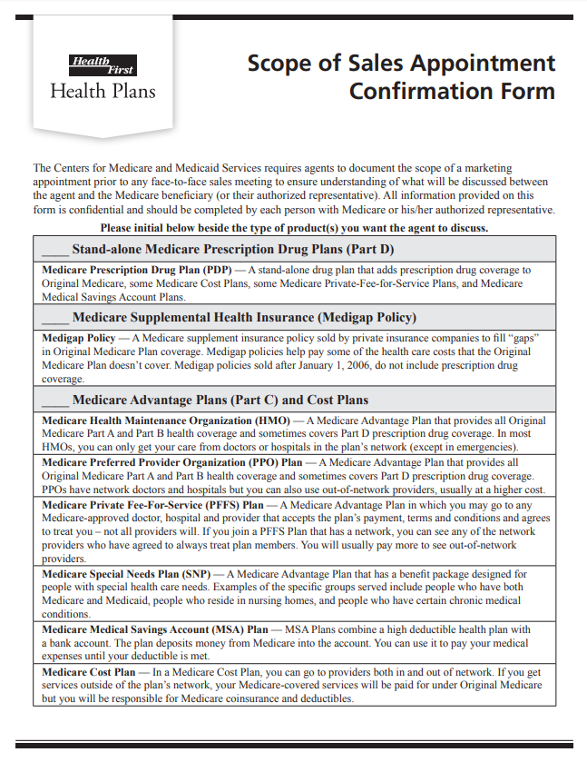
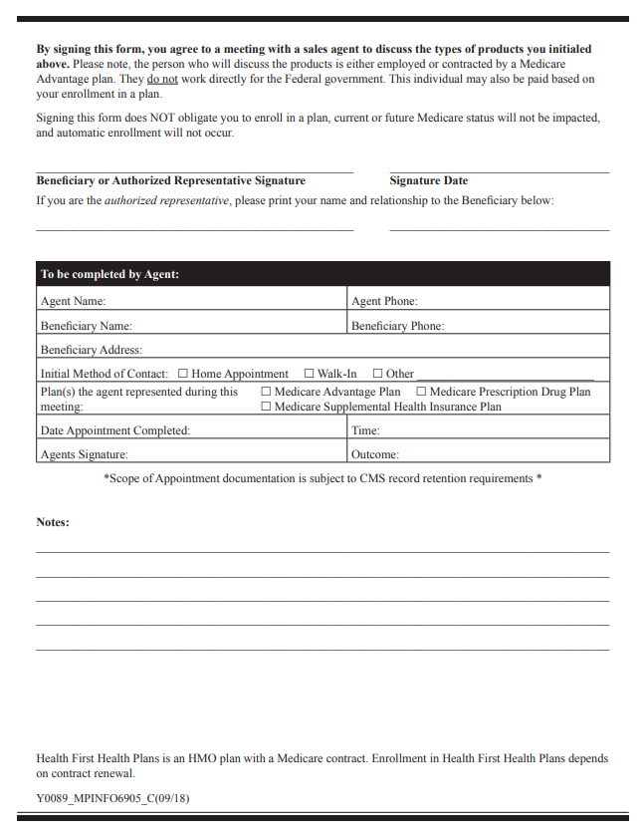
Scope of Appointment
How to Complete a Scope of Appointment (SOA)
Brokers may obtain an SOA form from the public website Brokers page.
Log in to either myHFHP.org or myAHplan.com
Select Brokers from the top navigation bar
From the Forms section, locate “Scope of Appointment”
Note: You may also obtain and complete the SOA through the Medicare Enrollment Portal electronically
Medicare beneficiaries complete the top section of the SOA. Brokers complete all lines of the “To be completed by Agent” box. A completed SOA should be submitted with each enrollment application.

Slide 8
Sales Presentation Process
Step 3: Broker Conducts Sales Presentation
During a sales presentation, the broker must:
Review Medicare basics, parts A, B, C and D
Review enrollment periods
Review benefit comparison
Review summary of benefits, formulary and directory
Answer questions
Complete enrollment, either electronically or via paper application
Sales presentations may be conducted:
In person
Virtually
Telephonically

Slide 9
Virtual Sales Presentation
Telephonic or Virtual MAPD Sales Presentations Are Acceptable
Here are some steps to follow to help you stay compliant while conducting business virtually:
Get consent. It is still a requirement that brokers receive consent from the Medicare beneficiary to conduct a sales call or proceed to a virtual sales presentation.
Collect a Scope of Appointment.
Send a marketing kit. Provide the Medicare beneficiary appropriate sales kit information ahead of time via email or postal service. This could include a benefit summary, star rating, formulary, etc. Give the beneficiary a chance to review prior to and be sure to reference during your virtual appointment.
Set an appointment. When conducting a virtual or telephonic sales presentation, conduct as you would in person.
Warm up with the prospect
Provide full disclosure
Complete needs analysis, drug search and provider lookup
Provide a complete benefits review
Answer questions
IMPORTANT: When conducting virtual or telephonic MAPD Sales Presentations, all current CMS Medicare marketing guidelines must be followed. It is good practice to record your call, showing your presentation has included all compliance measures.

Slide 10
Does the Beneficiary Have Other Insurance?
If the Beneficiary currently has health coverage from an employer or union, joining a plan could:
Affect their employer or union health benefits, including prescription drug coverage
Cause loss of the employer or union coverage
Important: The Beneficiary should read the communications their employer or union sends. If they have questions, they should visit their website or contact the office listed in their communications. If there isn’t any information on whom to contact, their benefits administrator or the office that answers questions about the coverage can help.

Slide 11
Medicare Beneficiary Enrollment
Step 4: Broker Enrolls Medicare Beneficiary and Submits a Signed Application
Health First Health Plans and AdventHealth Advantage Plans offer two options for submitting a Medicare application.
Electronic Enrollments
Submitted through the Broker Portal
Paper Applications
Fax to 833-582-2838 within 24 hours of signature

Slide 12
Expectations After Submitting the Signed Application
After submission by the Broker:
Health First Health Plans submits all enrollment applications to CMS.
If the prospective member is eligible, they are enrolled.
The member’s Evidence of Coverage (EOC) document, also known as their contract, is available upon request through customer service.
Within 10 calendar days, a member will receive:
An acknowledgment letter showing their member number, plan name and effective date. This can be used as proof of coverage until he/she receives their ID card.
Within 15 calendar days, a member will receive:
An enrollment verification letter. This letter verifies their enrollment request into our plan.
A member ID card that will be used for all medical and prescription needs in place of the red, white and blue Medicare card.
Within 90 calendar days, a member will receive:
A welcome call from the Member Engagement Department.

Slide 13
Premium Payment Options
Premium payment options for plans that require payment or late enrollment penalties:
Health First Health Plans (Classic, Value or LEPs):
Monthly invoices
Electronic funds transfer (EFT)
Social Security withholding (preferred option)
AdventHealth Advantage Plans (LEPs)
Monthly invoices
Electronic funds transfer (EFT)
Social Security withholding (preferred option)

Slide 14
Broker Responsibilities
DO’s
Follow Scope of Appointment guidelines.
Use the authorized Health First Health Plans’/AdventHealth Advantage Plans’ presentation – Digital presentation will be emailed upon request.
Submit the completed enrollment form within 24 hours of beneficiary signing.
Always use marketing materials that have been approved by Health First Health Plans, AdventHealth Advantage Plans and CMS. All marketing materials are required to be approved annually.
DON’Ts
Don’t promote non-healthcare-related products.
Don’t solicit/accept an enrollment request for a January 1 effective date prior to the start of the Annual Election Period (AEP) on October 15.
Don’t discuss plan options that were not agreed to in the SOA.

Slide 15
Consequences
Potential Consequences of Engaging in Inappropriate or Prohibited Marketing/Sales Activities:
Disciplinary action
Appointment termination
Forfeiture of future compensation
Complaints received by members or prospective members in reference to a Broker with any aspect of the Health Plan’s operations, activities or behavior are addressed via the Complaints Tracking Module (CTM).
For additional information, review the Broker Training Module: Broker Services Partner Integrity Program.

Slide 16
Helpful Contacts
Broker Services
321.434.5265
HFBroker@HF.org
Commissions
Commissions@HF.org
For plan year 2021 and prior questions
HF-brokercommissions@plusoscar.com
For plan year 2022 and beyond questions
Customer Service
Broker Support
Local: 321.434.4945
Toll Free: 877.693.6489
HFHPInfo@HF.org
HF-brokers@plusoscar.com

Slide 17
Thank You!

